Slide 1
ShallowBlue Chess AI
A brief introduction

Slide 2
The Problem
Reliable, sensible chess AI
Reasonable time performance
Better than novice skill level
Chess system for playing against AI
Network-based
Notes:
What is the problem you are trying to solve/question
you are trying to answer?

Slide 3
Others' Solutions
Well-explored area
Deep Blue
Commercial chess games
Pychess
Notes:
What have other people tried doing to solve it?

Slide 4
Others' Solutions
Popular features
Minimax search with Alpha/Beta pruning
Quiescence Search
Opening and end-game databases
Fast, efficient board state evaluation
Notes:
What have other people tried doing to solve it?

Slide 5
Our Methods
Minimax/Alpha-Beta/Quiescence Search search algorithm
Board state heuristics
Pieces on board
Attack posture
In check?
Empty space coverage
Notes:
What method have you used, and why?

Slide 6
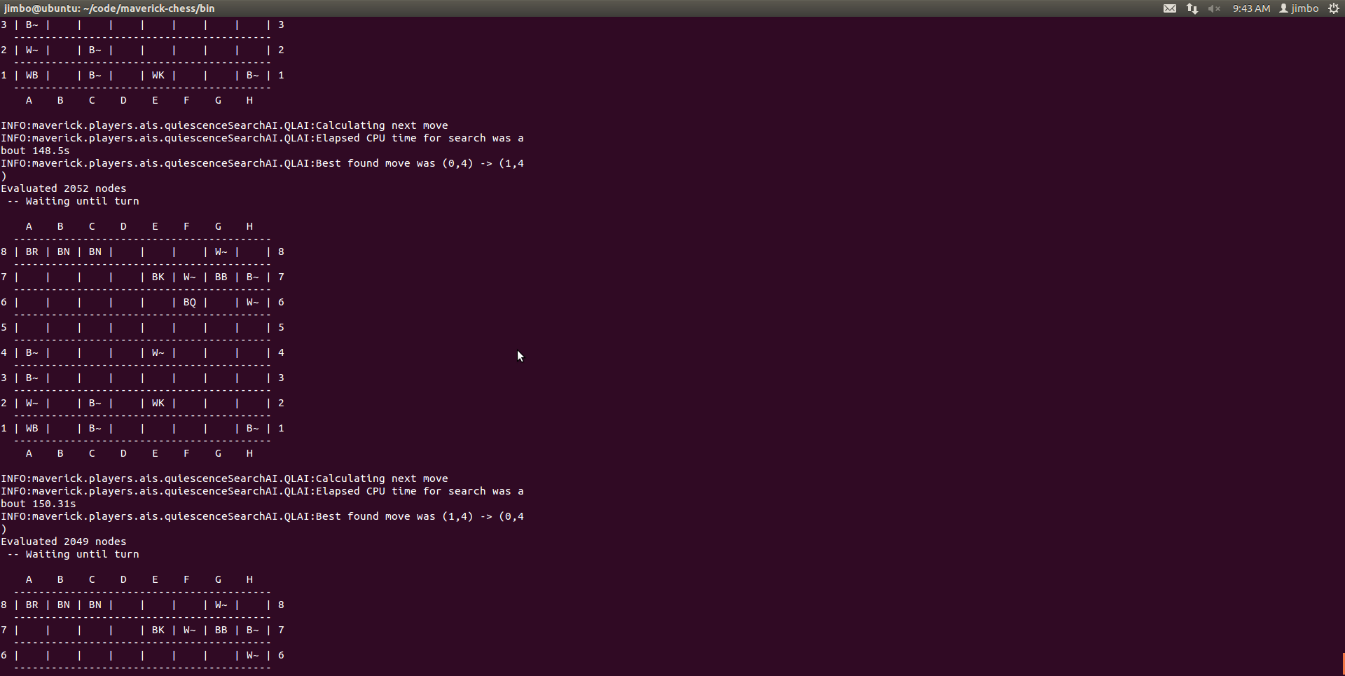
Progress So Far
Notes:
What are your results so far?

Slide 7
Progress So Far
Network-based chess system
Rules enforcement
Checkmate detection
Minimax search
alpha/beta pruning
Board heuristics

Slide 8
Progress So Far
Testing in progress
Making sensible moves
Capturing pieces
Moving to control empty spaces
Losing to random moves
This is to be expected!

